Slide 1
Relational Data Model
CE3101 - Bases de Datos

Slide 2
Disclaimer / Descargo de Responsabilidad
Esta presentación corresponde a una guía usada por el profesor durante las clases. La misma ha sido modificada para ser utilizado en el modelo de cursos asistidos por tecnología. No es una versión final, por lo que la misma podría requerir todavía hacer algunos ajustes. Para aspectos de evaluación esta presentación es solo una guía, por lo que el estudiante debe profundizar con el material de lectura asignado y lo discutido en clases para aspectos de evaluación.
This presentation corresponds to a guide material used by the professor during classes. It has been modified to be used in the model of technology-assisted courses. It is not a final version, so it may still require some adjustments. For evaluation aspects, this presentation is only a guide, so the student should delve with the assigned reading material and what has been discussed in class.

Slide 3
Pregunta inicial
Los perros ladran, los gatos maúllan, los pájaros pían.
Que hacen las jirafas?

Slide 4
The Relational Data Model
The relational data model was first introduced by Ted Codd of IBM Research in 1970.

Slide 5

The Relational Data Model
The relational data model was first introduced by Ted Codd of IBM Research in 1970.

Slide 6
The Relational Data Model
The relational data model was first introduced by Ted Codd of IBM Research in 1970.
The model uses the concept of a mathematical relation.
The first commercial implementation of the relational model became available in the early 1980.

Slide 7
Relational Model Concepts
CONCEPTS
The relational model represents the database as a collection of relations.
Informally, each relation resembles a table of values or, to some extent, a flat file of records.
A row represent a fact that typically corresponds to a real-world entity or relationship.

Slide 8
Relational Model Concepts
CONCEPTS
The relational model represents the database as a collection of relations.
Informally, each relation resembles a table of values or, to some extent, a flat file of records.
A row represent a fact that typically corresponds to a real-world entity or relationship.
The table name and column names are used to help to interpret the meaning of the values in each row.

Slide 9
Relational Model Concepts
CONCEPTS
TERMINOLOGY
Represents the database as a collection of relations.
Each relation resembles a table of values or flat file of records.
A row represent a fact that typically corresponds to a real-world entity or relationship.
In the formal relational model terminology:
A row is called a tuple.
A column header is called an attribute.
A table is called a relation.

Slide 10
Domains, Attributes, Tuples and Relations
DOMAIN
A domain D is a set of atomic values.
Names: The set of character strings that represents names of personas.
Employee ages: Possible ages of employee in a company; each must be an integer value between 15 and 80.
A data type or format is also specified for each domain.

Slide 11
Domains, Attributes, Tuples and Relations
DOMAIN
A domain D is a set of atomic values.
Names: The set of character strings that represents names of personas.
Employee ages: Possible ages of employee in a company; each must be an integer value between 15 and 80.
A data type or format is also specified for each domain.
RELATION
A relation schema R, denoted by R(A1, A2,…, An), is made up of a relation name R and a list of attributes A1, A2,..., An. Each attribute Ai is the name of a role played by some domain D in the relation schema R.
The degree of a relation is the number of attributes n of its relation schema.
Using the data type of each attribute.

Slide 12
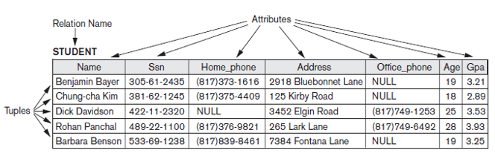
Domains, Attributes, Tuples and Relations

Slide 13
Characteristics of Relations
Ordering of tuples in a relation. Elements of a set have no order among them.
Ordering of values within a tuple. An n-tuple is an ordered list of n values.

Slide 14
Characteristics of Relations
Ordering of tuples in a relation. Elements of a set have no order among them.
Ordering of values within a tuple. An n-tuple is an ordered list of n values.
Values and NULL is the tuples. Each value in a tuple is an atomic value.
Interpretation (meaning) of a relation. The relation schema can be interpreted as a declaration or a type of assertion.

Slide 15
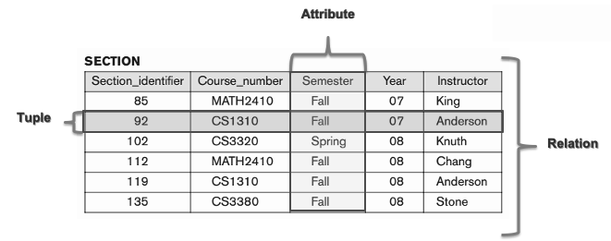
Essential Concepts
All attribute values belong to the same domain

Slide 16
Relational Model Constraints
It is a feature of a database using the relational model.
Three categories:
Inherent model-based constraints or implicit constraints
Schema-based constraints or explicit constraints
Application-based or semantic constraints or business rules

Slide 17
Inherent model-based constraints or implicit constraints
DEFINITION
Restrict the values that can be stored considering the model definition.

Slide 18
Inherent model-based constraints or implicit constraints
DEFINITION
Restrict the values that can be stored considering the model definition.
EXAMPLE
A relation cannot have duplicate tuples is an inherent constraint.

Slide 19
Application-based or semantic constraints or business rules
DEFINITION
Some restrictions reflect complex business rules.
Due to their complexity can not be expressed in the data model, so that should be implemented at the level of code in the application or in a trigger.

Slide 20

Application-based or semantic constraints or business rules
DEFINITION
Some restrictions reflect complex business rules.
Due to their complexity can not be expressed in the data model, so that should be implemented at the level of code in the application or in a trigger.
EXAMPLE

Slide 21
Schema-based constraints or explicit constraints
DEFINITION
Are defined when creating the schema in the deployment model (relational in this case).
Are expressed in the language DDL

Slide 22
Schema-based constraints or explicit constraints
DEFINITION
Are defined when creating the schema in the deployment model (relational in this case).
Are expressed in the language DDL
CATEGORIES
Domain Constraints.
Key Constraints and Constraints on NULL Values.
Integrity, Referential Integrity and Foreign Keys.

Slide 23
Domain Constraint
DEFINITION
Specify that the value of each attribute A must be an atomic value from the domain dom(A).
The data types associated with the domains typically include standard numeric data types for integers.
Other possible domains may be described by a subrange of values from a data type or as an enumerated data type in which all possible values are explicitly listed.

Slide 24
Key Constraints and Constraints on NULL Values
DEFINITION
A relation is defined as a set of tuples.
By definition all elements of a set are distinct; hence, all tuples in a relation must also be distinct.

Slide 25

Key Constraints and Constraints on NULL Values
DEFINITION
A relation is defined as a set of tuples.
By definition all elements of a set are distinct; hence, all tuples in a relation must also be distinct.
Denote one subset of attributes by SK; then for any two distinct tuples t1 and t2 in a relation state r of R, we have the constraint that:

Slide 26
Key Constraints and Constraints on NULL Values
DEFINITION
Any such set of attributes SK is called a superkey of the relation schema R.
A superkey SK specifies a uniqueness constraint that no two distinct tuples in any state r of R can have the same value of SK.

Slide 27
Key Constraints and Constraints on NULL Values
DEFINITION
Any such set of attributes SK is called a superkey of the relation schema R.
A superkey SK specifies a uniqueness constraint that no two distinct tuples in any state r of R can have the same value of SK.
Every relation has at least one default superkey— the set of all its attributes.
A key K of a relation schema R is a superkey of R with the additional property that removing any attribute A from K leaves a set of attributes K that is not a superkey of R any more.

Slide 28
Key Constraints and Constraints on NULL Values
DEFINITION
It is a minimal superkey—that is a superkey from which we cannot remove any attributes and still have the uniqueness constraint.

Slide 29
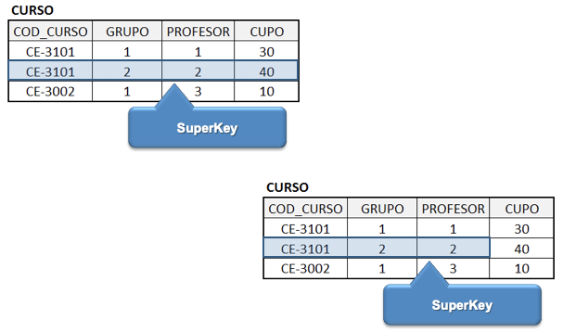
Key Constraints and Constraints on NULL Values

Slide 30
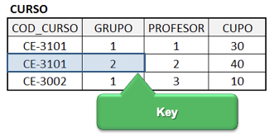
Key Constraints and Constraints on NULL Values

Slide 31
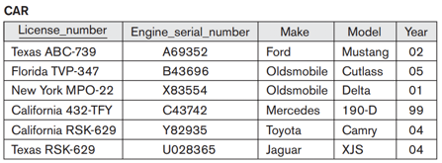
Key Constraints and Constraints on NULL Values
A relation may have more than one key
The choice of one to become the primary key is somewhat arbitrary.
It is usually better to choose a primary key with a single attribute or a small number of attributes.

Slide 32
Key Constraints and Constraints on NULL Values
A relation may have more than one key
The choice of one to become the primary key is somewhat arbitrary.
It is usually better to choose a primary key with a single attribute or a small number of attributes.
Attributes specifies whether NULL values are or are not permitted

Slide 33
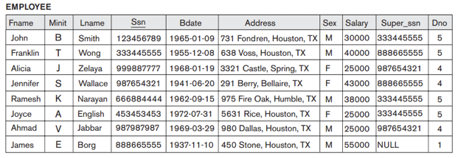
Integrity
The entity integrity constraint states that no primary key value can be NULL

Slide 34
Integrity
The entity integrity constraint states that no primary key value can be NULL
NULL values are not permitted

Slide 35
Referential Integrity
The referential integrity constraint is specified between two relations and is used to maintain the consistency among tuples in two relations.
Informally, the referential integrity constraint states that a tuple in one relation that refers to another relation must refer to an existing tuple in that relation.

Slide 36
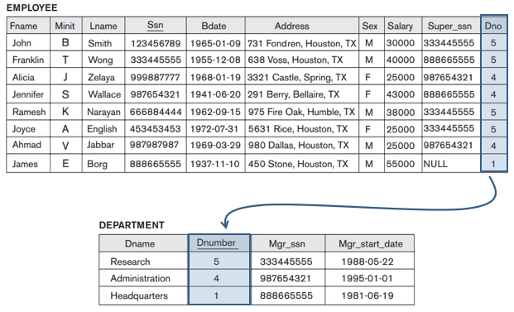
Referential Integrity

Slide 37
Respues a pregunta inicial
Las jirafas no emiten sonido alguno convirtiéndose de esta manera en el único mamífero con esta característica

Slide 38
Relational Data Model
CE3101 - Bases de Datos

